Slide 1




Credit Card Fraud Detection
Using Machine Learning Methods
April 18th, 2025
Keerthanaa Ellur
Masters in Information Systems
Dr. Daoji Li
Associate Professor of Statistics and Data Science
Notes:
Good afternoon, everyone. My name is Keerthanaa Ellur, a graduate student in Information Systems at California State University, Fullerton.
Today, I’m excited to present my research on Credit Card Fraud Detection using Machine Learning methods, under the guidance of Dr. Daoji Li, Associate Professor of Statistics and Data Science.
This topic is incredibly relevant, especially in today’s digital economy where online transactions have surged—and so has fraudulent activity.
We'll explore how machine learning can help us proactively detect and prevent fraudulent transactions.

Slide 2





Agenda
Introduction
Diving deeper into the dataset
Goal
Machine Learning Methods
Results
Future Work

Slide 3




Introduction
“
Protecting Customers & Financial Institutions
This study aims to identify and prevent fraudulent transactions in real-time by analyzing patterns and anomalies in transaction data
Prevent unauthorized charges
?
Why
Mitigate financial losses and reputational risks
Rapid detection
Notes:
Let me begin by explaining why this problem matters.
Credit card fraud is a major concern for both financial institutions and consumers. It causes billions of dollars in annual losses globally.
More importantly, fraud can severely impact consumer trust and financial stability.
Therefore, it’s critical for credit card companies to recognize and respond to fraudulent activity in real-time, ideally before the customer even notices it.

Slide 4

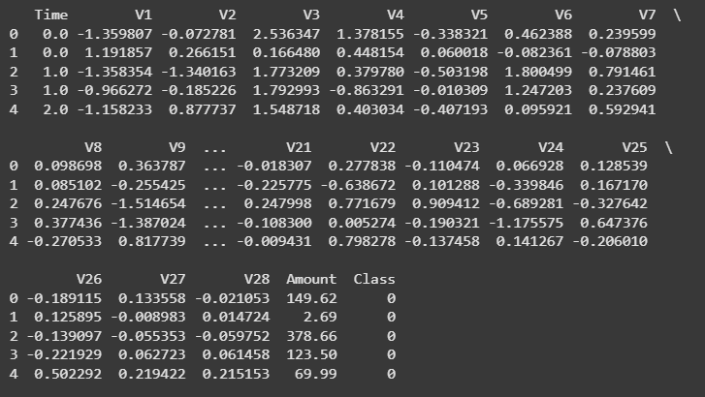

Diving deeper into the dataset
Source
Transactions by European cardholders, September 2013 from
284,807 transactions
29 features
0 and 1
Class target variable
Dataset: Table of credit card transactions with Time, V1–V28, Amount & Class.
Notes:
Let me walk you through the dataset we used.
Source: Transactions by European cardholders, September 2013 (Kaggle) It contains 284,807 transactions, each described by 29 features, and the target variable is called ‘Class’—with 0 representing a legitimate transaction and 1 indicating fraud.
To protect user privacy, features were transformed using PCA, a technique that hides personal information while keeping patterns in the data.
We standardized all features so that each method could fairly compare them.

Slide 5

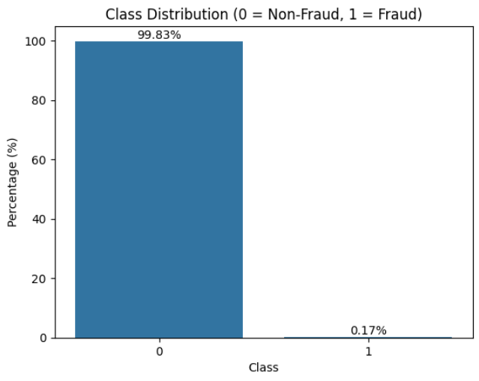
Goal
Goal: Classify each transaction as fraudulent or legitimate.
Evaluation Focus: Emphasis on precision, recall, and f1-score for the fraud class.
Bar chart: Non-Fraud 99.83% vs Fraud 0.17%. Illustrates severe class imbalance in the dataset.
Notes:
The objective of this study is to correctly classify transactions into fraud or non-fraud.
With such severe imbalance—the fraudulent cases making up only 0.172%—it is crucial to look beyond overall accuracy.
Instead, our focus is on precision (Of the transactions flagged as fraud, how many were actually fraud?), recall (Of all the actual frauds, how many did the model catch?), and the f1-score which balances the two.

Slide 6






Machine Learning Methods
Naïve Bayes
Logistic Regression
Linear Discriminant Analysis (LDA)
Quadratic Discriminant Analysis (QDA)
K-Nearest Neighbors (KNN)
Notes:
We explored various machine learning methods to tackle this classification problem. Logistic Regression provides a strong baseline, while KNN classifies based on similarity. LDA and QDA offer insights with linear and quadratic decision boundaries respectively, and Naive Bayes gives us a fast, probability-based approach.

Slide 7

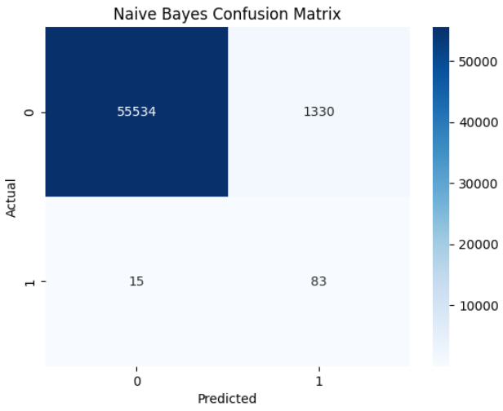
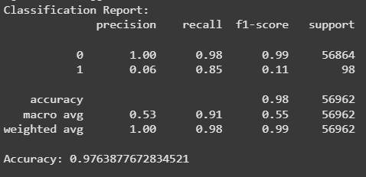
Naïve Bayes
Naive Bayes confusion matrix and classification report with precision, recall, f1-score, and support.
Concept: Leverages Bayes’ Theorem and assumes independence among features.
Key Consideration: Fast and efficient, but the independence assumption leads to many false positives
Notes:
Naive Bayes is known for its efficiency because it uses Bayes’ Theorem under the assumption that all features are independent.
Although it provides a good recall of 0.85, meaning it detects a large portion of the fraud cases, its precision is very low at 0.06.
This results in many non-fraud transactions being misclassified as fraud, which limits its practical application despite its computational speed.

Slide 8

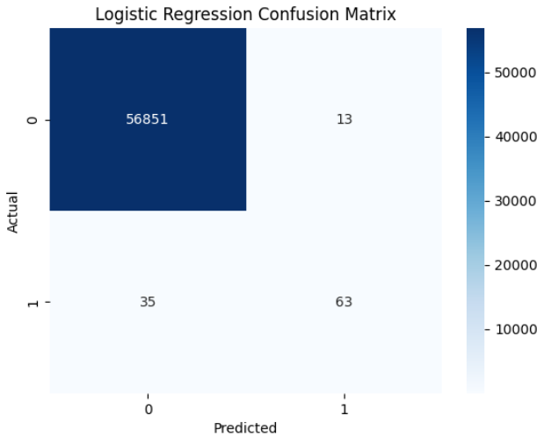
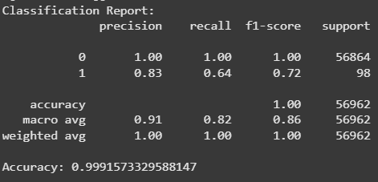
Logistic Regression
Logistic Regression: 99.92% accuracy, 0.83 precision, 0.64 recall, 0.72 F1-score.
Concept: It models the probability that a transaction is fraudulent based on a linear combination of input features (precision 0.83, recall 0.64).
Key Insight: Serves as a simple, interpretable baseline that is effective at flagging fraud but misses some cases.
Notes:
Logistic Regression is a straightforward method for binary classification. It estimates the probability of fraud based on all the input features.
Think of it like a checklist—if enough red flags are present, it calls it fraud.
In our model, a precision of 0.83 means that 83% of transactions predicted as fraud are indeed fraud, which minimizes false positives. However, a recall of 0.64 indicates that about 36% of actual fraud cases are missed. So it was cautious—not many false alarms—but it missed quite a few fraud cases.
It’s interpretable and efficient, which makes it a solid starting point.
Precision: Out of all samples predicted as fraud (1), how many were truly fraud. 0.83 = 63/(63+13)
Recall: Out of all actual fraud cases, how many were correctly detected. 0.64 = 63/(63+35)
F1-Score: Harmonic mean of precision and recall, balancing both. 0.72 for fraud detection.
Accuracy: The overall percentage of correct predictions. 0.9991 or ~99.91%, which is high due to class imbalance (very few fraud cases compared to non-fraud).

Slide 9

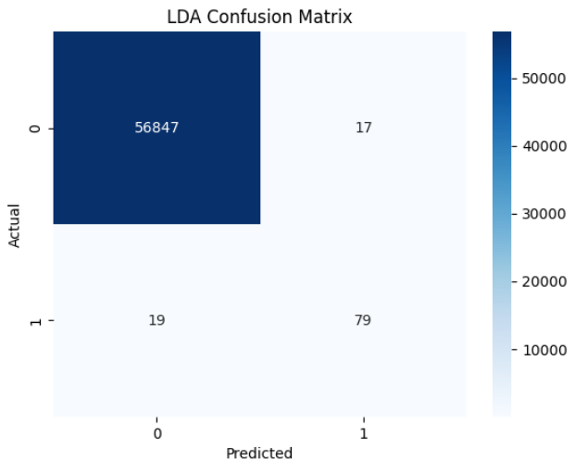
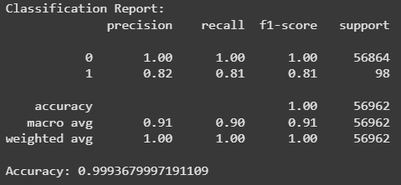
Linear Discriminant Analysis (LDA)
Concept: Finds linear combinations of features to best separate the classes.
Advantage: Highly efficient for high-dimensional datasets.
LDA confusion matrix and classification report with precision, recall, f1-score, and support.
Notes:
Linear Discriminant Analysis draws a boundary to separate fraud and non-fraud based on assumptions of normal distribution.
It’s fast and works well when those assumptions hold.
> A precision of 0.82 means that when the LDA model predicts a transaction as fraudulent, it is correct 82% of the time. In parallel, a recall of 0.81 indicates that the model successfully identifies 81% of all actual fraudulent cases—capturing a large portion of the fraud instances.

Slide 10

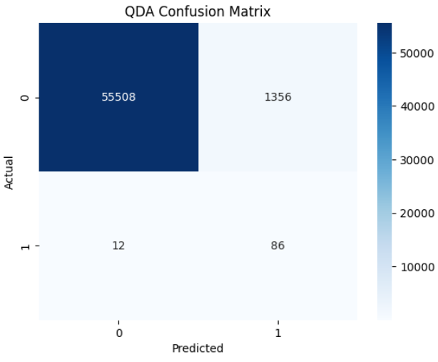

Quadratic Discriminant Analysis (QDA)
QDA confusion matrix and classification report with precision, recall, f1-score, and support.
Concept: Similar to LDA but allows each class to have its own covariance matrix, resulting in quadratic boundaries.
Key Note: While recall is high, the low precision indicates many false positives.
Notes:
Quadratic Discriminant Analysis is more flexible than LDA. It allows the model to draw curved boundaries to better fit complex patterns.
This increased recall to 0.88, meaning it caught almost all frauds.
But precision dropped to 0.06, meaning 94% of its fraud alerts were false alarms.
So while it’s sensitive, it’s not practical without extra filtering.

Slide 11

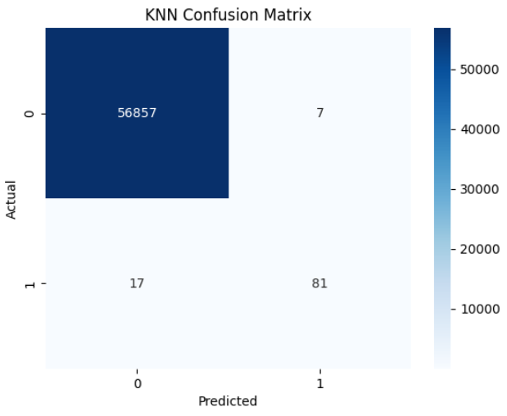
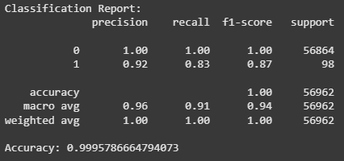
K-Nearest Neighbors (KNN)
Concept: Classifies transactions by finding the majority label among the k-nearest neighbors.
Advantage: Can capture non-linear patterns in the data.
KNN (k=3): 0.92 prec, 0.83 rec, 0.87 F1; overall accuracy 99.96%.
Notes:
KNN doesn’t “learn” in advance. When a new transaction shows up, it checks the most similar past transactions and votes on whether it’s fraud.
Imagine if your bank sees a charge and compares it to five others like it—if most of those were fraud, this one probably is too.
> Regarding performance, a precision of 0.92 means that when KNN labels a transaction as fraudulent, it is correct 92% of the time—this shows that the model is very effective at minimizing false positives. An f1-score of 0.87 indicates a strong balance between precision and recall; recall measures the proportion of actual fraud cases that are detected by the model.
> > In short, It performed the best overall—but it can be slow in real-time because it needs to search a lot of historical data.

Slide 12

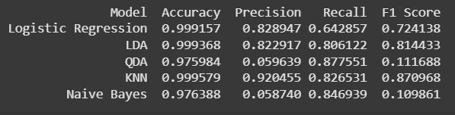
Results
Robust Evaluation with 80% data for Train and 20% Test
Key takeaway: We can achieve 92% precision with KNN method
Comparison of machine learning methods for fraud detection: accuracy, precision, recall, and F1 scores.
Notes:
We split the data into 80% for training and 20% for testing to ensure robust evaluation.
Although overall accuracy is very high—due to the severe class imbalance—we focus on precision, recall, and the f1-score for fraud detection.
For instance, Logistic Regression achieves 83% precision and 64% recall,
while LDA offers 82% precision and 81% recall.
QDA and Naive Bayes, despite high recall, have low precision (around 6%), resulting in many false alarms.
In contrast, KNN stands out with 92% precision and 83% recall, providing the best balance in correctly identifying fraud cases without excessive false positives.

Slide 13




Additional Considerations
Investigate anomaly detection methods.
Incorporate cost-sensitive learning to better handle the costs of false negatives.
Future Work
Addressing Imbalance
Explore data augmentation techniques such as SMOTE or adaptive resampling.
Consider ensemble methods (Boosting, Bagging) to improve detection balance.
Deep Learning/AI
Experiment with CNNs, RNNs, LLMs or other architectures for automatic feature extraction
Final Emphasis:
Improve the balance between detecting fraud and minimizing false alarms.
Notes:
As good as the results are, our dataset’s severe class imbalance remains a challenge.
In the future, we plan to:
Use techniques like SMOTE for oversampling the fraud class
Experiment with cost-sensitive learning, which penalizes false negatives more
Explore Deep Learning methods, such as:
Convolutional Neural Networks (CNNs) for spatial patterns (recognize spatial relationships in transaction features.)
Recurrent Neural Networks (RNNs) for time-series fraud
Large Language Models (LLMs) to detect fraud using unstructured transaction data
These advanced methods can help us better detect subtle, evolving fraud behaviors.
SMOTE (Synthetic Minority Over-sampling Technique) addresses class imbalance by generating synthetic minority examples along the line segments between existing instances and their nearest neighbors, thereby creating a more balanced dataset for improved decision boundaries.

Slide 14


THANK YOU
Keerthanaa Ellur
kellur0@csu.fullerton.edu
Dr. Daoji Li
dali@fullerton.edu

Slide 15

Q&A

